Slide 1

IM(Mobility) during a pandemic
How has Covid-19 affected asylum seekers in the EU?

Slide 2
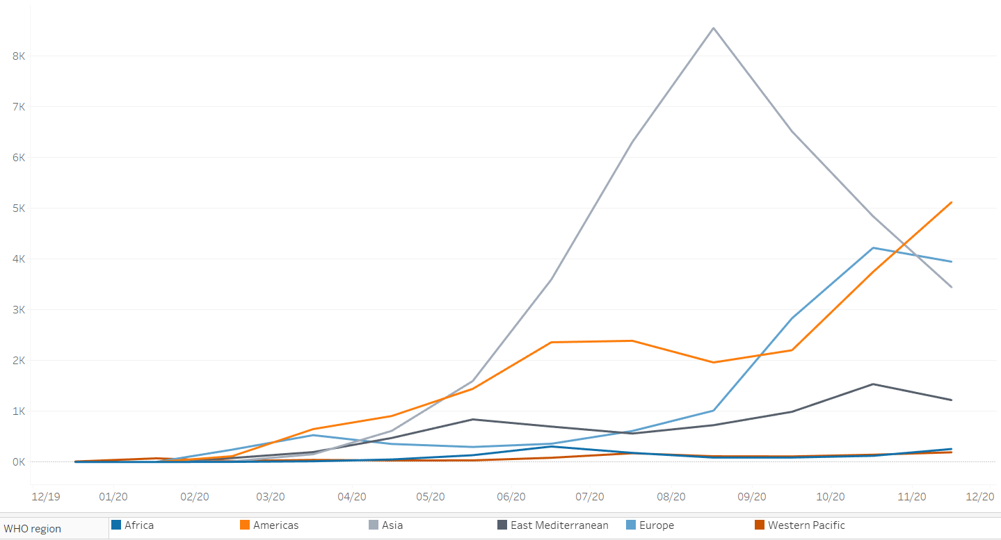

Slide 3



Slide 4


Slide 5


Slide 6


Slide 7
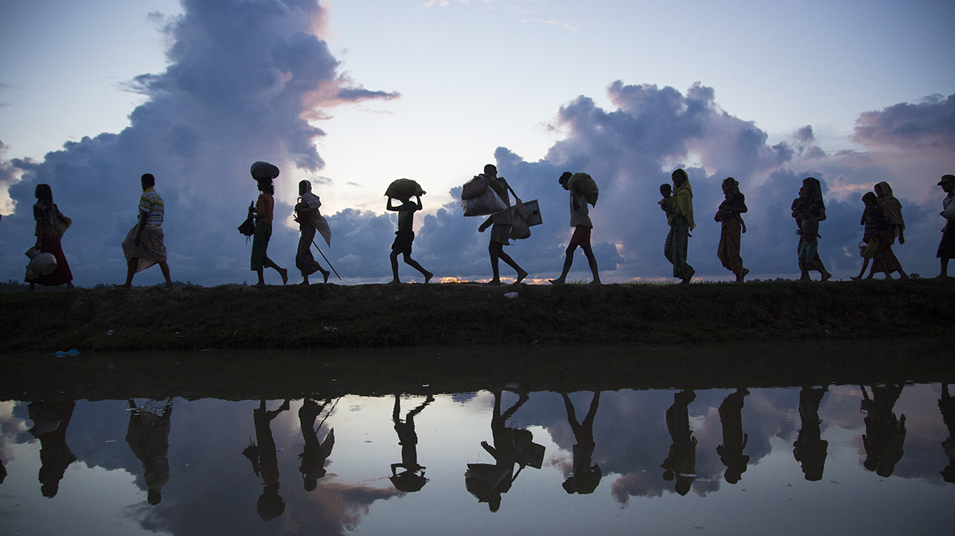
Fleeing the virus and ...
… persecution because of race, religion, nationality, social group or political opinion.

Slide 8
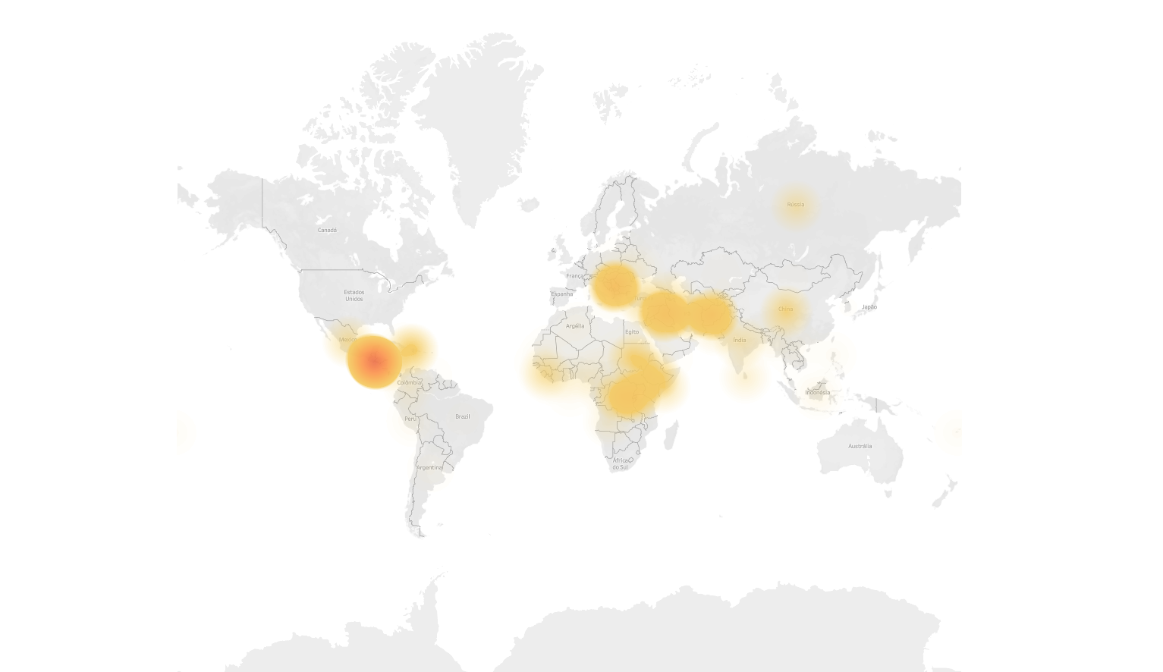

Slide 9
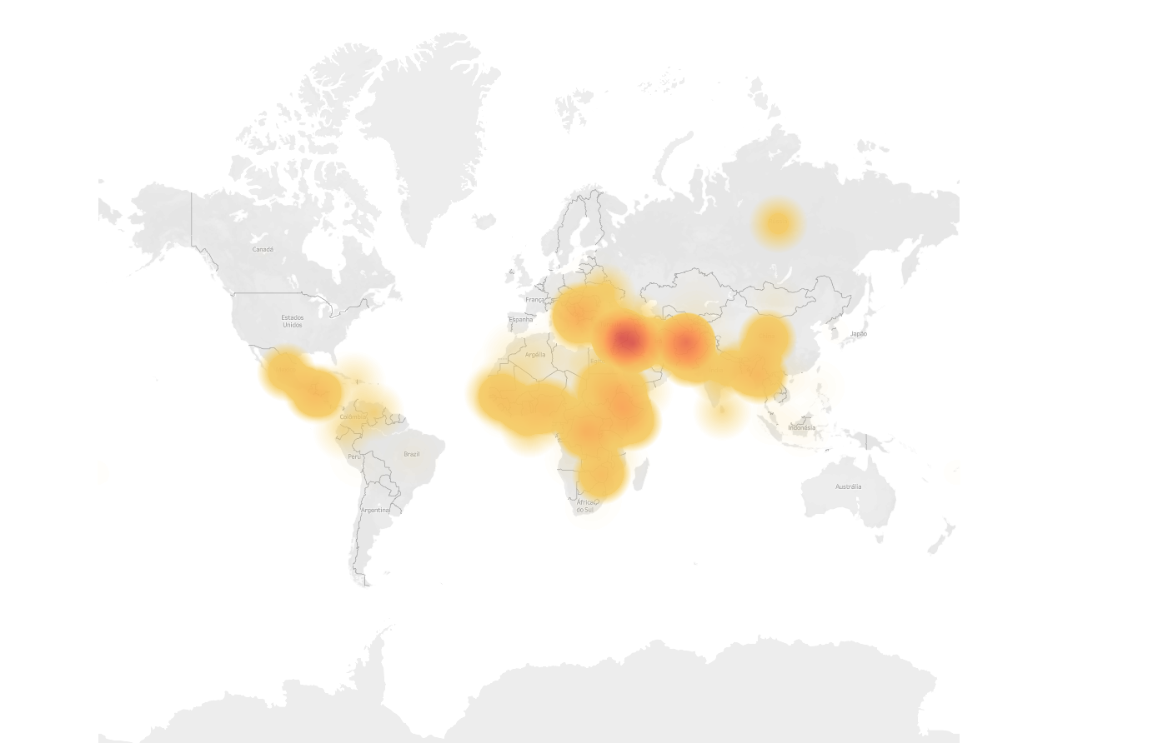

Slide 10
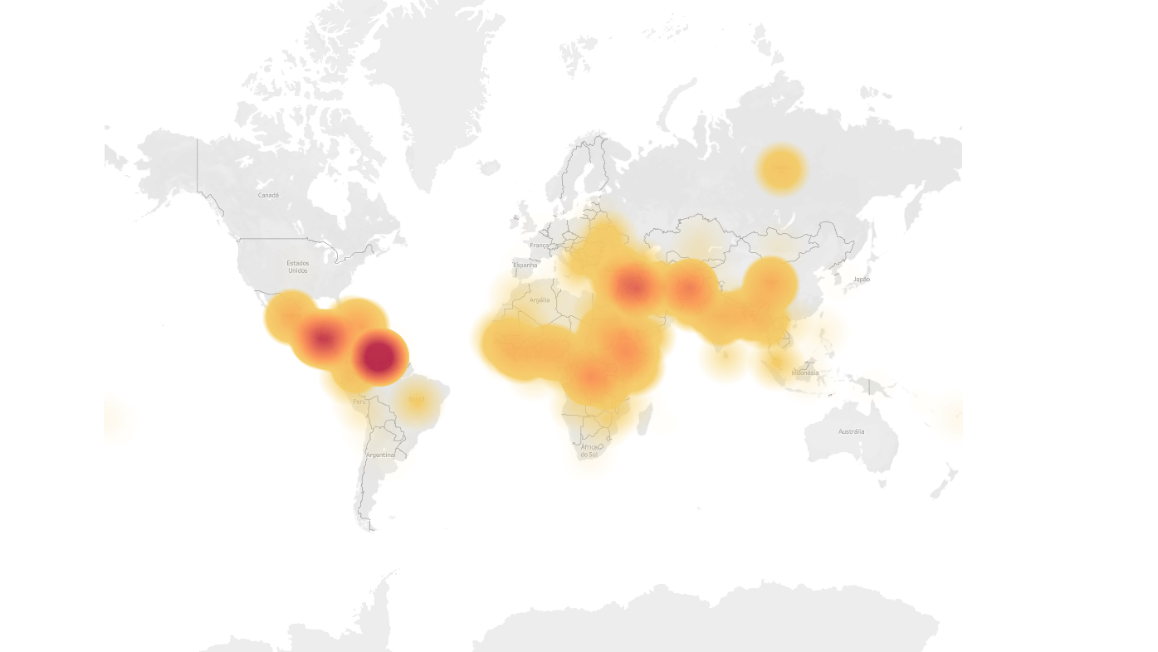

Slide 11
80.383.510

Slide 12
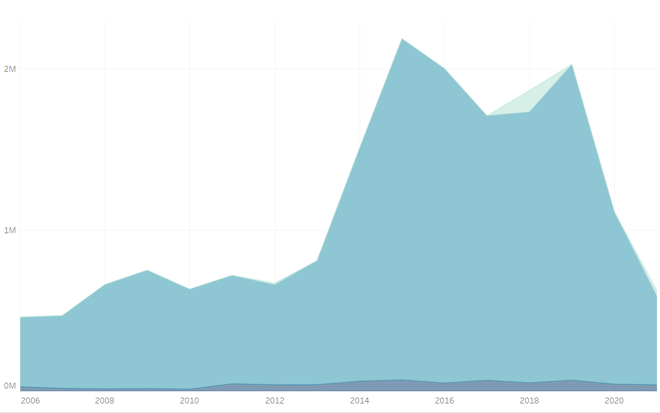
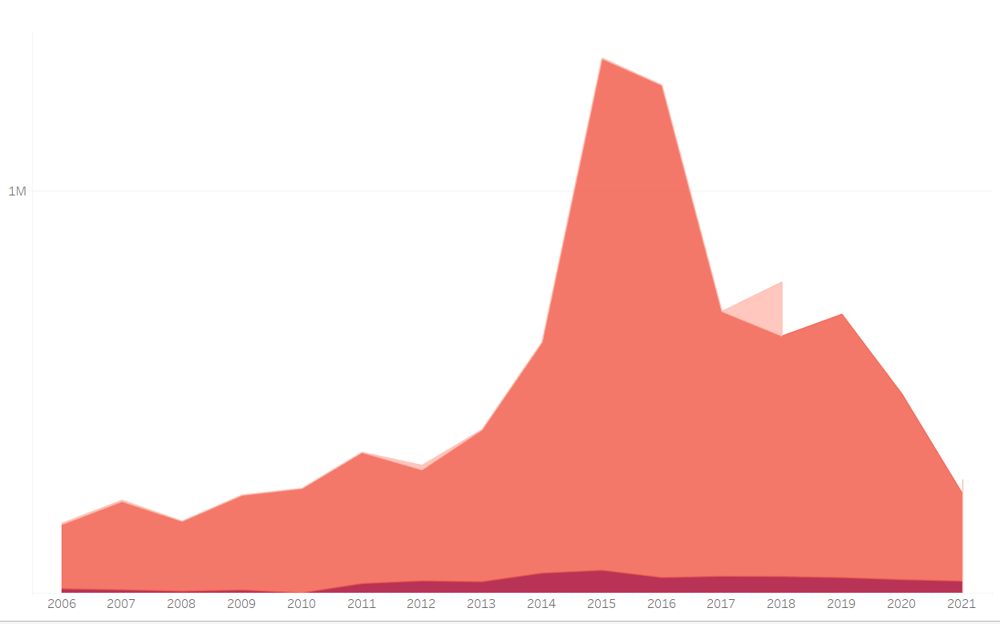
Asylum claims

Slide 13
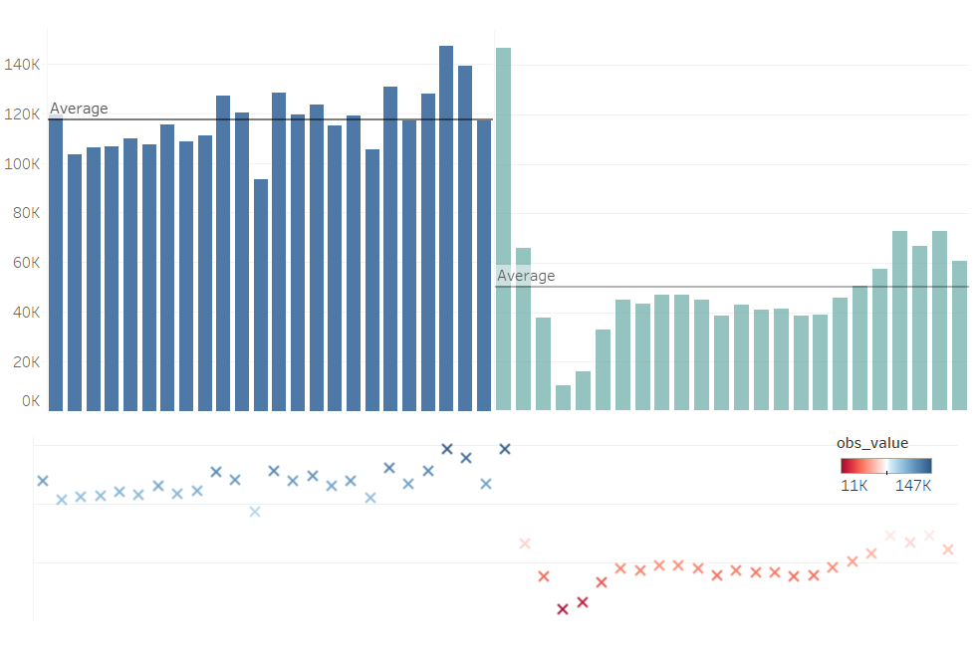

Slide 14
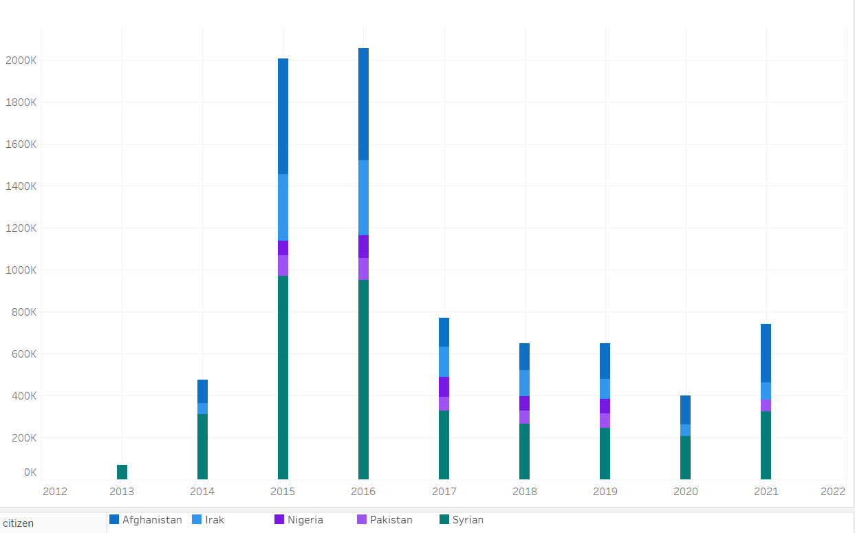

Slide 15
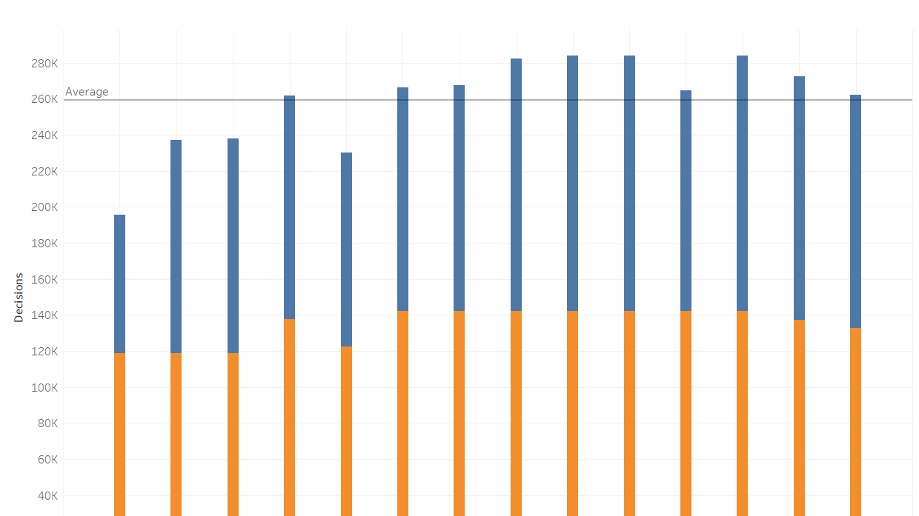
DECISIONS ON ASYLUM
Year | Ratio
2008 2009 2010 2011 2012 2013 2014 2015 2016 2017 2018 2019 2020 2021 | 1.446299 1.326879 1.365228 1.324737 1.344070 1.373064 0.587509 0.428111 0.878127 1.358412 0.878144 0.765582 1.098846 0.411705

Slide 16

DECISIONS ON ASYLUM
Year | Ratio
2008 2009 2010 2011 2012 2013 2014 2015 2016 2017 2018 2019 2020 2021 | 1.446299 1.326879 1.365228 1.324737 1.344070 1.373064 0.587509 0.428111 0.878127 1.358412 0.878144 0.765582 1.098846 0.411705

Slide 17
CONCLUSION
-Average monthly number of asylum claims since 2018 dropped by more than 50%
-Average number of decisions overcame average number of applications
Further investigation
-Investigate resettlements, deportations, smuggling
-Compare gender, age, studies.

Slide 18
THANK YOU

